Slide 1
Application for
secure email exchange
Kfir Gaon
Shoval Yehuda
Roman Ratchitski
Rafael Mosheyoff

Slide 2



Table of Contents
01
Introduction
Background, Timeline
02
The Algorithm
AES ,CFB ,EL-GAMAL ,Elliptic-curve
03
Advantages VS Disadvantages
AES ,CFB ,EL-GAMAL ,Elliptic-curve
04
Summary
Conclusions, References and Bibliography

Slide 3
Introduction

Slide 4
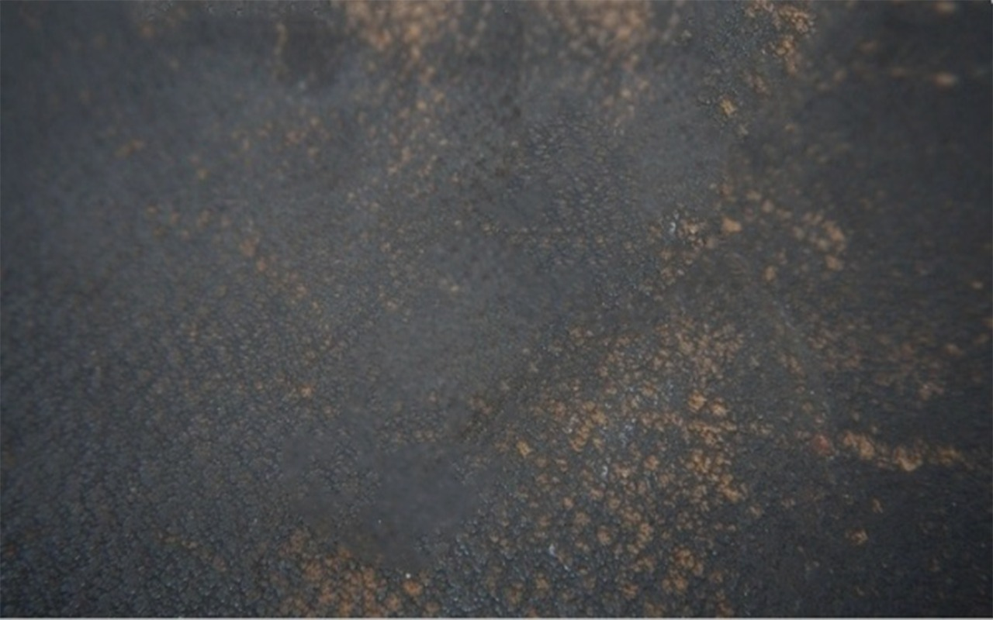
Background
The history
Information security is the industry that deals with the protection of access, use, disclosure, eavesdropping, disruption, copying or destruction of information
and information systems by unauthorized or malicious entities and providing confidentiality, integrity and availability of the information regardless of the type of information or form of storage, physical or electronic.

Slide 5
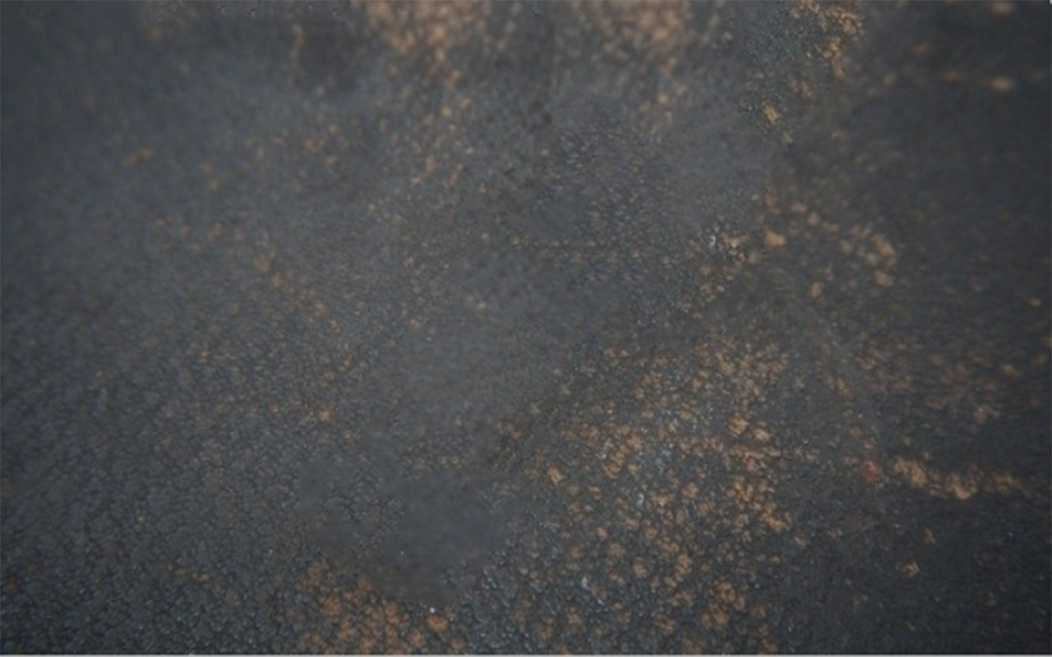
Timeline
CFB
ElGamal encryption
The Modes belonged to fips 81. 2010 have been approved as a safe use by NITS.
It was described by Taher Elgamal in 1985.
1981
1985
1985
1999-2001
Elliptic Curve
AES
The use of elliptic curves in cryptography was suggested independently by Neal Koblitz and Victor S.Miller in 1985.
established by the U.S. National Institute of Standards and Technology (NIST) in 2001.

Slide 6
The Algorithm

Slide 7

AES
Advanced Encryption Standards

Slide 8
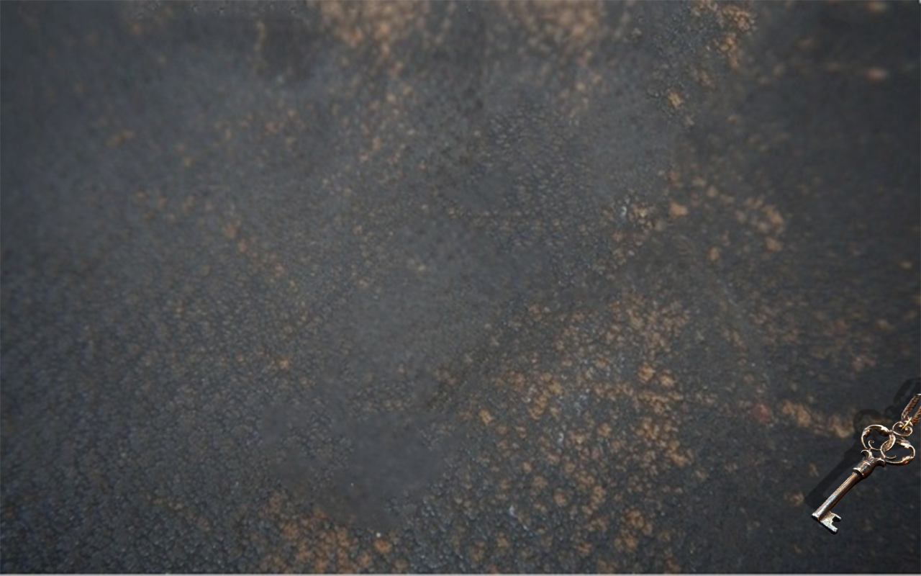
Description of the algorithm
Overview
Advanced Encryption Standards (AES) is a cryptographic
cipher that is responsible for a large amount of the
information security that we enjoy nowadays.
Applied by organizations like NSA, Microsoft, Apple, etc..
AES is one of the most important cryptographic algorithms
being used in 2018.
What exactly is AES? How does it work? And can people
like you and me trust on it to keep us safe?
That’s exactly what we will be discussing in this presentation.

Slide 9
AES
The features
The advanced encryption algorithm(AES) is a symmetric algorithm.
Advanced Encryption Standard(AES) came into play since the key size of DES is very small.
Block encryption implementation.
Symmetric key symmetric block cipher.
Data of 128 bits with 128, 192 and 256-bit key lengths.
Compared to triple-DES –it tends to be faster and stronger.
Provide full specification and design details.
Easy overall implementation.
Data security for 20-30 years.
Worldwide access.

Slide 10
AES
The AES Cipher
The key size used for this cipher specifies the number of repetitions or “rounds” required to put the plaintext through the cipher and convert it into ciphertext.
Here’s how the cycles break down:
10 rounds are required for a 128-bit key.
12 Rounds are required for a 192-bit key.
14 Rounds are required for a 256-bit key.
You have to pay attention While longer keys provide the users with stronger encryptions,
the strength comes at the cost of performance, meaning that they will take longer to encrypt.

Slide 11
AES
Description of encryption process
Key Expansion – round keys are derived from the cipher key using the AES key schedule. AES requires a separate 128-bit round key block for each round plus one more.
Initial round key addition:
AddRoundKey – each byte of the state is combined with a byte of the round key using bitwise xor.
9, 11 or 13 rounds:
SubBytes – a non-linear substitution step where each byte is replaced with another according to a lookup table.
ShiftRows – a transposition step where the last three rows of the state are shifted cyclically a certain number of steps.
MixColumns – a linear mixing operation which operates on the columns of the state, combining the four bytes in each column.
AddRoundKey

Slide 12
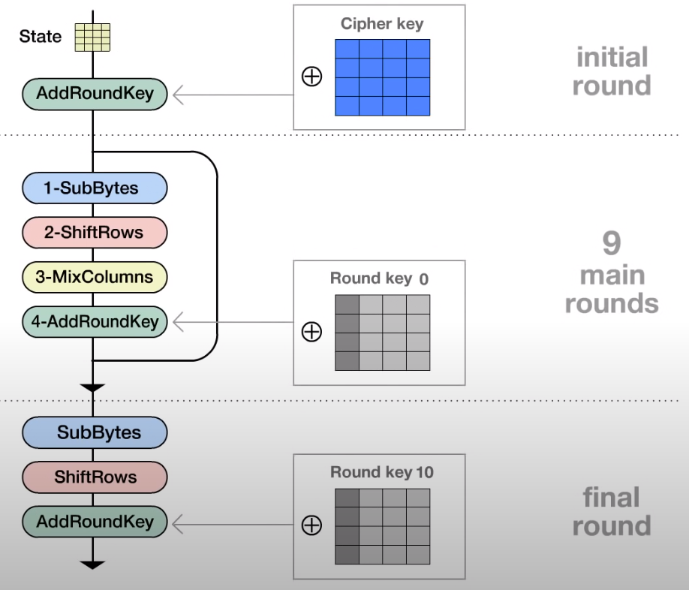
AES
Description of encryption process
Final round (making 10, 12 or 14 rounds in total):
SubBytes
ShiftRows
AddRoundKey

Slide 13
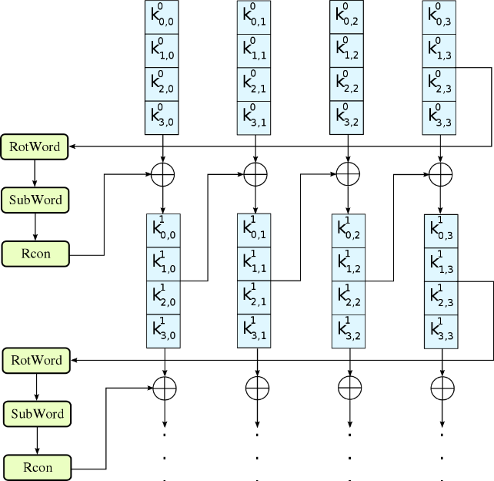
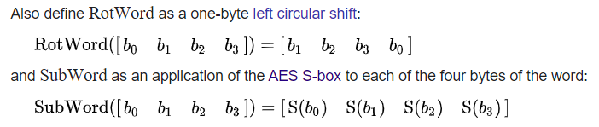
AES
1 - Key Expansion
Round keys are derived from the cipher key using the AES key schedule.
AES requires a separate 128-bit round key block for each round plus
one more.
AES uses a key schedule to expand a short key into a number of
separate round keys.
The three AES variants have a different number of rounds.
Each variant requires a separate 128-bit round key for each round
plus one more.
The key schedule produces the needed round keys from the initial key.

Slide 14
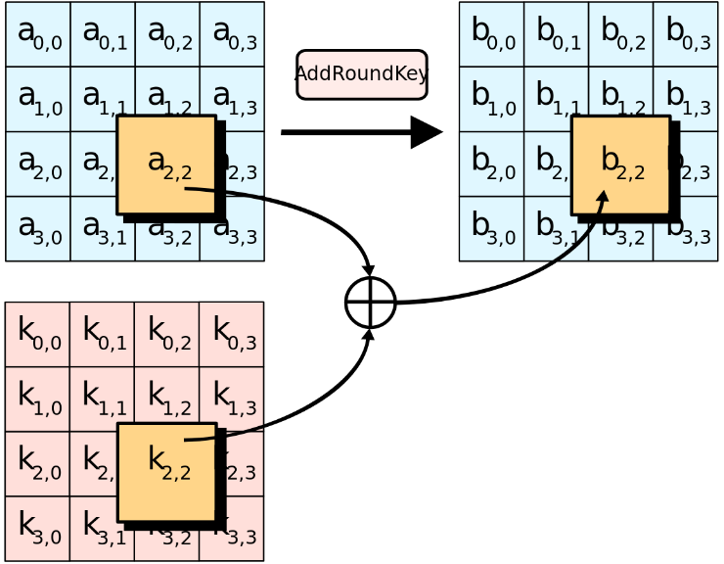
AES
2 - Initial round key addition
AddRoundKey – In the AddRoundKey step, the subkey is combined with the state.
For each round, a subkey is derived from the main key using Rijndael's key schedule.
each subkey is the same size as the state. The subkey is added by combining each byte of the state with the corresponding byte of the subkey using bitwise XOR.

Slide 15
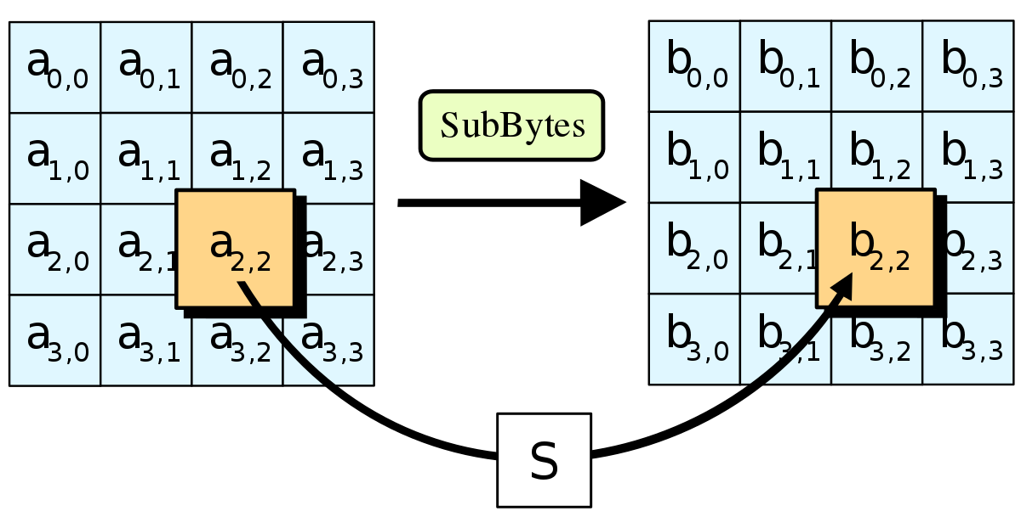
AES
3 - 9,11 or 13 Rounds
1. SubBytes – a non-linear substitution step where each byte is replaced with another according to a lookup table. The 16 input bytes are substituted by looking up a fixed table (S-box) given in design. The result is in a matrix of four rows and four columns.

Slide 16
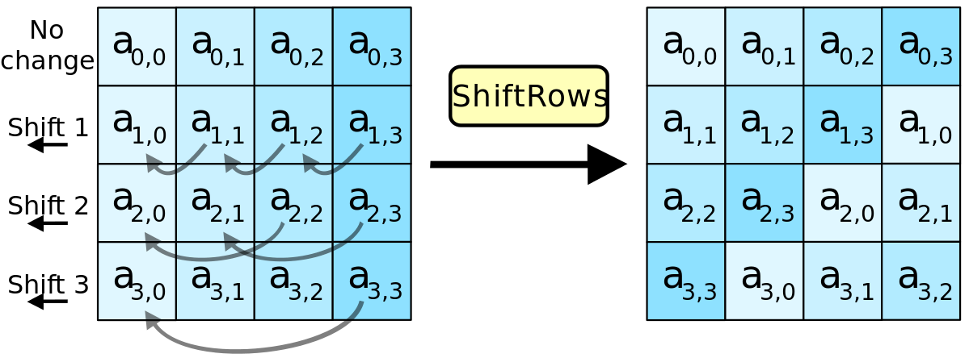
AES
3 - 9,11 or 13 Rounds
2. ShiftRows – The ShiftRows step operates on the rows of the state. it cyclically shifts the bytes in each row by a certain offset. Each of the four rows of the matrix is shifted to the left. Any entries that ‘fall off’ are re-inserted on the right side of row. Shift is carried out as follows:
First row is not shifted.
Second row is shifted one (byte) position to the left.
Third row is shifted two positions to the left.
Fourth row is shifted three positions to the left.
The result is a new matrix consisting of the same 16 bytes but shifted with respect to each other.

Slide 17
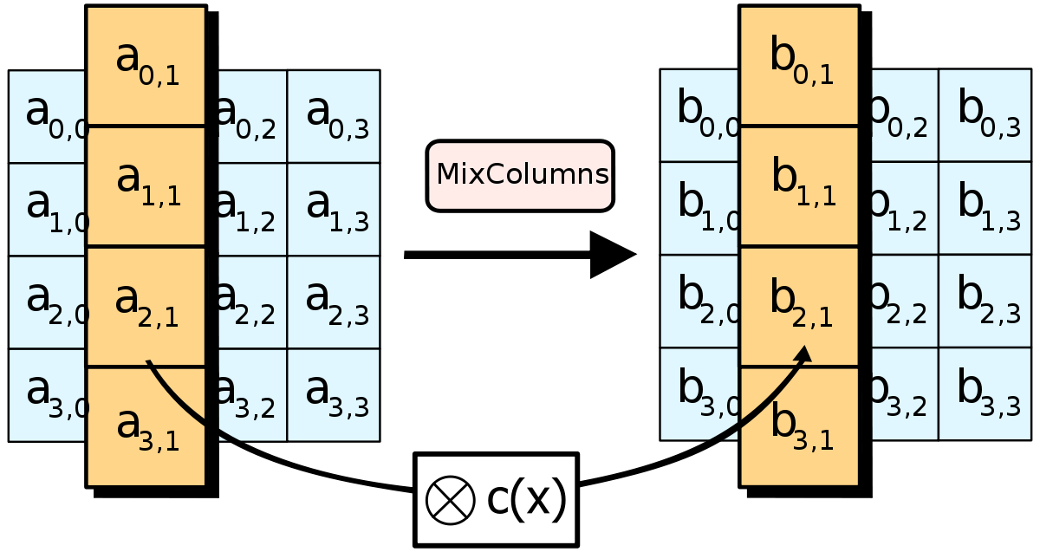
AES
3 - 9,11 or 13 Rounds
3. MixColumns – Each column of four bytes is now transformed using a special mathematical function. This function takes as input the four bytes of one column and outputs four completely new bytes, which replace the original column. The result is another new matrix consisting of 16 new bytes. It should be noted that this step is not performed in the last round.

Slide 18
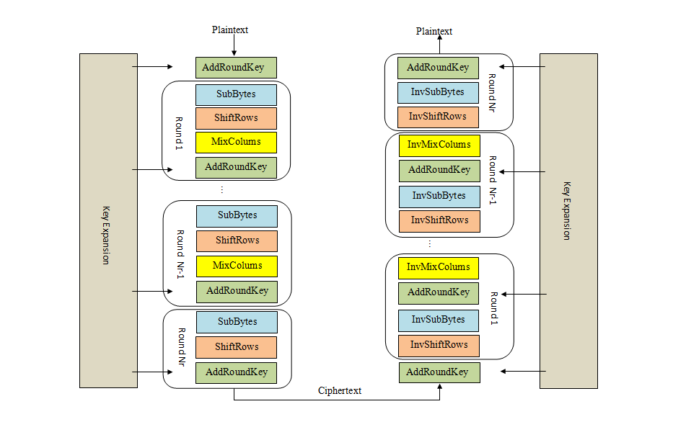
AES
Description of Decryption process
The decryption process is very similar to the encryption process, but this works in the reverse of the same process, Hence as like encryption here Each round consists of the four processes carried out in the reverse order.
The three stage of decryption are as follows:
Inverse Final Round
AddRoundKey
ShiftRows
SubBytes
Inverse Main Round
AddRoundKey
MixColumns
ShiftRows
SubBytes
Inverse Initial Round
AddRoundKey

Slide 19

CFB
Cipher Feedback mode

Slide 20
CFB
The cipher feedback (CFB) mode differs from the others in that the plaintext never passes through the encryption algorithm at all.
Instead an initialization vector (IV) is encrypted and the result is exclusive with the
plaintext to create the ciphertext of a block.
An initialization vector (IV) is a block of bits that is used to randomize the encryption and hence to produce distinct ciphertexts .
A block cipher works on units of a fixed size (known as a block size), but messages come in a variety of lengths. So some modes (namely ECB and CBC) require that the final block be padded before encryption.

Slide 21
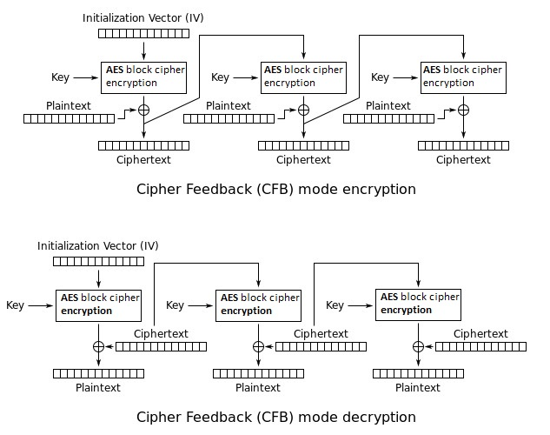
AES with CFB

Slide 22

El-Gamal
Asymmetric key encryption algorithm

Slide 23
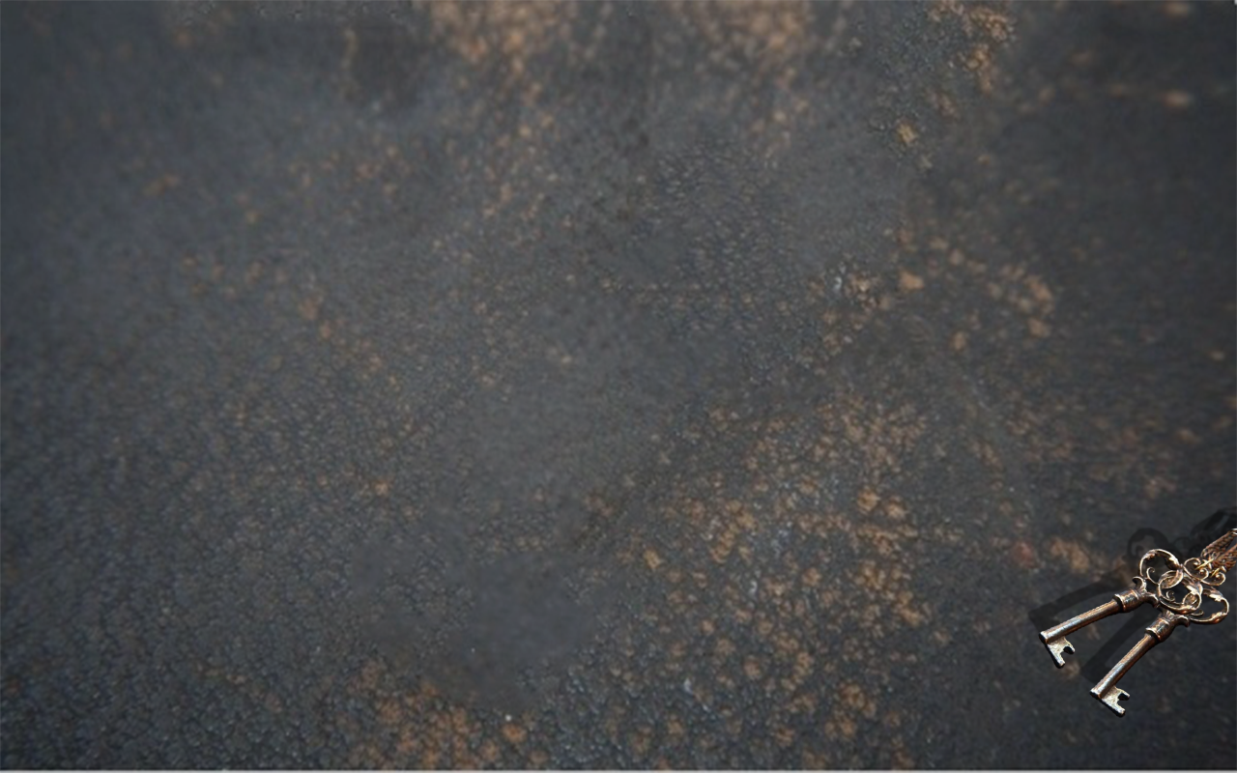
Description of the algorithm
Overview
In cryptography, the ElGamal encryption system is an asymmetric key encryption algorithm for public-key cryptography which is based on the Diffie–Hellman key exchange.
It was described by Taher Elgamal in 1984.
ElGamal encryption consists of three components:
the key generator, the encryption algorithm, and the decryption algorithm.

Slide 24


EL-GAMAL
Alice creates:
a (Private key)
A = aP (Public key)
Decryption
Bob and Alice agree on an
elliptic curve-based point (P)
K, C
Bob wants to send message (M)
Bob created random value of k
S = aK
M = C-S
K = kP
C = KA+M
Proof: M = C-S = KA + M - aK = KaP + M - aKP

Slide 25
EL-GAMAL
Methods
We can use El-Gamal with different methods for example:
with ECC, we take points on a defined curve - such as Curve 25519 - and then perform point
addition and subtraction.
So how can we convert the ElGamal method into ECC?
01
First, Alice first creates a private key (a) - and which is a random scalar value - and a public key (aP) - and which is a point on the elliptic curve.
02
P is the base point on a curve.
03
Alice’s public key will then be: A=aP

Slide 26
EL-GAMAL
Methods
If Bob wants to send Alice an encrypted message (M), he creates a random value (k)
and uses her public key (A) to produce a cipher message of: K= kP
And then the next with: C= kA+M
And where M is matched to a point on the elliptic curve.
Now Alice receives (K) and (C), and computes: S= aK
And then computes the message with: M= C−S
As C and S will be points on the elliptic curve, this will be done with a point subtraction operation.
Overall this will recover the original message as: C−S= kA+M−aK= kaP+M−akP = M

Slide 27

ECC
Elliptic Curve Cryptography

Slide 28
Description of the algorithm
Overview
Elliptic Curve (EC) systems as applied to cryptography were first proposed in 1985 independently
by Neal Koblitz and Victor Miller.
The resources available to crack encrypted keys continues to expand,
meaning the size of encrypted keys must continue to grow in order to
reman secure hence ECC has been slowly gaining in popularity over the past few years due to its ability to provide the same level of security as RSA
with a much smaller key size.

Slide 29
Elliptic Curves
RSA /DSA (modulus size in bits) | ECC – Based Scheme (size of n in bits)
512 | 112
1024 | 160
248 | 224
3072 | 256
7680 | 384
15360 | 512

Slide 30




Elliptic Curves
Applications of Elliptic curve Cipher
Wireless communication devices
Many devices are
small and have
limited storage and
computational power.
Where can we apply
ECC?
Smart cards
Web servers that need to handle many encryption sessions
The cryptocurrency Bitcoin is a distributed
peer-to-peer digital currency.

Slide 31
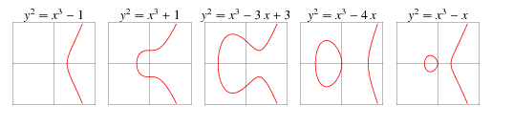

Elliptic Curves
Elliptic curve model
An Elliptic Curve (EC) is the set of solutions to an equation of the form: $Y^{2}=X^{3}+AX+B$
Together with an extra point 𝒪 where the constants A and B must satisfy: ${4A}^{3}+27B^{2}≠0$
Example:

Slide 32

Elliptic Curves
Elliptic curve properties
Theorem: Let E be an elliptic curve. Then the addition law on E has the following properties (for all P, Q, R ∈ E):
Closure: $P+Q∈E$
Identity: $P+𝒪=𝒪+P=P$
Inverse element: $P+\left(−P\right)=𝒪$
Associativity: $(P+Q)+R=P+(Q+R)$
Commutativity: $P+Q=Q+P$
In the other words, EC is an Abelian group under the addition law.

Slide 33
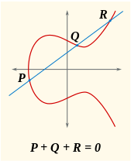
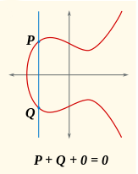
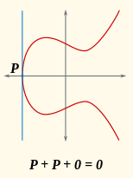
Elliptic Curves
Elliptic curve solution
For the case x1 ≠ x2
For the case x1 = x2 and y1 = -y2
For the case x1 = x2 and y1 = y2
Addition is defined as follows:
(x₁,y₁) + (x₂,y₂) = (x₃,y₃) ∈ E where
x₃ = m² - x₁ - x₂
y₃ = m*(x₁ – x₃) - y₁ , and
m = (y₂ – y₁) / (x₂ – x₁)
Addition is defined as follows:
(x₁,y₁) + (x₂,y₂) = (x₃,y₃) ∈ E where
(x,y) + (x,-y) = O, the point at infinity
Addition is defined as follows:
(x₁,y₁) + (x₂,y₂) = (x₃,y₃) ∈ E where
x₃ = m² - x₁ - x₂
y₃ = m(x₁ – x₃) - y₁, and
m = (3x₁² + a) / 2y₁

Slide 34





Elliptic Curves
Elliptic curve improvement
Example:
Compute:
So, we can compute
$$E:y^{2}=x^{3}+x+6 \text{over} Z_{11}$$
$$α=(2,7)$$
$$3α=(x_{3},y_{3})$$
$$λ = \frac{y_{2}−y_{1}}{x_{2}−x_{1}}=\frac{2−7}{5−2}=2 \operatorname{mod}{ } 11 \\ x_{3} = λ^{2}−x_{1}−x_{2}=2^{2}−2−5=8 \operatorname{mod}{ } 11 \\ y_{3} = \left(x_{1}−x_{3}\right)λ−y_{1}=\left(2−8\right)×2−7=3 \operatorname{mod}{ } 11$$
$$\begin{matrix}α=(2,7) & 2α=(5,2) & 3α=(8,3) \\ 4α=(10,2) & 5α=(3,6) & 6α=(7,9) \\ 7α=(7,2) & 8α=(3,5) & 9α=(10,9) \\ 10α=(8,8) & 11α=(5,9) & 12α=(2,4)\end{matrix}$$

Slide 35











Elliptic Curves
Elliptic curve improvement
Example:
Compute:
So, we can compute
$$E:y^{2}=x^{3}+x+6 \text{over} Z_{11}$$
$$α=(2,7)$$
rounds(n) = { if n % 2 == 0: return (n/2)-1, return (n/2)
$$10α=(x_{3},y_{3})$$
$$11α=(x_{3},y_{3})$$
rounds(10) = 4
rounds(11) = 5
$2α=\left(2,7\right)+\left(2,7\right)=\left(5,2\right)$
$2α=\left(2,7\right)+\left(2,7\right)=\left(5,2\right)$
$4α=\left(5,2\right)+\left(5,2\right)=\left(10,2\right)$
$4α=\left(5,2\right)+\left(5,2\right)=\left(10,2\right)$
$8α=\left(10,2\right)+\left(10,2\right)=\left(3,5\right)$
$8α=\left(10,2\right)+\left(10,2\right)=\left(3,5\right)$
$10α=\left(3,5\right)+\left(5,2\right)=\left(8,8\right)$
$10α=\left(3,5\right)+\left(5,2\right)=\left(8,8\right)$
$11α=\left(8,8\right)+\left(2,7\right)=\left(5,9\right)$

Slide 36

Code recap
Click

Slide 37
Advantages
VS Disadvantages

Slide 38
Advantages And Disadvantages
Advanced encryption standard
Advanced
It can be implemented in both hardware and software.
Long key size (128,192 and 256 bits) makes AES more robust hacking.
Three keys give the user a choice as per their requirement based upon speed and security.
Disadvantages
It uses to simple algebraic structure.
Every block is always encrypted in the same way.
Hard to implement with software.

Slide 39
Advantages And Disadvantages
Cipher feedback block
Advanced
Equal messages using the same keys will be encrypted to different ciphertexts.
Message length can be arbitrary.
Random of IV is not needed.
CFB feed back gives the cipher text which we can get save inside any memory.
That you access both cipher and decipher text.
Disadvantages
Message blocks cannot be decrypted from any part or re-encrypted after modification.
Encryption speed is significantly slower.
CPU is not free during the whole process of the cipher text.

Slide 40
Advantages And Disadvantages
ElGamal encryption
Advanced
One of the strength of ElGamal is its non-determinism-encrypting the same plaintext multiple
times will result in different ciphertexts, since a random k is chosen each time.
El-Gamal encryption is used in the free GNU privacy Guard Software.
Disadvantages
Its need for randomness, and its slower speed(especially for signing).
The potential disadvantage of the ElGamal system is that message expansion by a factor of two takes place during encryption ( means the ciphertext is twice as long as the plaintext.)

Slide 41
Advantages And Disadvantages
Elliptic Curves
Advanced
Greater flexibility in choosing cryptographic system.
no known sub exponential time algorithm for ECDLP ⇒ smaller key sizes (with the same security).
Current recommendation the minimum key size for ECC should be 132 bits vs. 952 bits for RSA.
As a result: greater speed, less storage ⇒ ECC can be used in smart cards, cellular phones,
pagers etc.
Disadvantages
Hyperelliptic cryptosystems offer even smaller key sizes.
ECC is mathematically more subtle than RSA or SDL ⇒ difficult to explain/justify to the client.

Slide 42
Summary

Slide 43
Conclusions
Advanced encryption standard
Nowadays cryptography, AES is adopted and supported in both hardware and software.
Till date, no practical cryptanalytic attacks against AES has been discovered.
AES has built-in flexibility of key length, which allows a degree of ‘future-proofing’
against progress in the ability to perform exhaustive key searches.

Slide 44
Conclusions
Cipher feedback block
Block cipher may provide excellent cryptographic properties, but for practical Application
they need modes of operation (for example CFB).
Such modes of operation may be used both for confidentiality and integrity.
The modes of operation of block ciphers are configuration methods that allow those
ciphers to work with large data streams, without the risk of compromising the provided security.

Slide 45
Conclusions
ElGamal Cipher
ElGamal encryption is probabilistic, meaning that a single plaintext can be encrypted to many
possible ciphertexts, with the consequence that a general ElGamal encryption produces
a 2:1 expansion in size from plaintext to ciphertext.
Encryption under ElGamal requires two exponentiations, however, these exponentiations are independent of the message and can be computed ahead of time if need be.
Decryption requires one exponentiation and one computation of a group inverse which can however be easily combined into just one exponentiation.

Slide 46
Conclusions
Elliptic curve
Although elliptic curve cryptography hasn't yet reached the masses in terms of adoption, it has been said to be the next generation of cryptography.
With its ability to provide the same security as RSA while remaining much smaller in
since, this make ECC an attractive alternative.
As technology advances and computers become more powerful, the size of RSA keys will be forced to increase as the act of cracking an RSA key will become easier.
This is sub-optimal for any device, the use of a larger RSA key will require more resources, however this is exactly what ECC sets out to rectify.

Slide 47
References and Bibliography
Dr. Renata Avros, Lectures Information Security and Cryptology, 2020
Mr. Gavinet Itai, Practices Information Security and Cryptology, 2020
National Institute of Standards and Technology, 2001 AES (click)
Wikipedia Block cipher mode of operation, 2020 CFB (click)
Daniel R. L. Brown, SEC Elliptic Curves, 2010 (click)
Prof Bill Buchanan OBE, El-Gamal and ECC, 2019 (click)

Slide 48
Thank you
Team 29

